Slide 1
IHSMarkit and UT Austin CCUS GOM Data Prototype
March 2022
Michael Pyrcz
The University of Texas at Austin

Slide 2
Operational Capability Development
‘We are the original data-driven science, we have been big data long before tech learned about big data!’
1930-1940s
1950-1960s
1980-1990s
>1990s
Probability and Stationarity
Kolmogorov
Volume Variance in Mining
Krige
Geostatistics
Mathematical Morphology
Matheron
Applications in Oil and Gas, Environmental
Journel, Verly, Deutsch
Spatial Statistics, Big Data Analytics and Machine Learning
‘We are the original data science, we have been doing it for a long time!’

Slide 3
Summary
Fast sprint to prototype components of the proposed GeoDataAnalytics workflow for CCUS potential prediction with demonstration with IHSMarkit Gulf of Mexico data.
Goal
Provide well-documented prototypes of workflow components in Jupyter
Demonstrate codes, methods, sequential flow, diagnostics / visualizations to support implementation
Comments
Results should not be used for decision making
In sprinting forward to fast prototypes, I have made assumptions to fill gaps, for example:
Only static pore volume calculation, no effect to capture injectivity and trapping
Coordinates were not projected to North American Datum and used as original lats and longs.
Fluid types and ages were mixed in some analysis, outliers are retained

Slide 4
The CCUS Workflow
Reservoir Information (e.g., rock volume, porosity, temperature, pressure)
Regional Trend Maps
Basin Trend Maps
For more information see the proposal document, UHSMarkit_UTAustin_Q1_2022_CCUS_Proposal.docx.
Main Workflow Steps
Feature Selection
Dimensionality Reduction
Feature Imputation
Feature Engineering
Workflow Outputs
While there are many intermediate outputs the main outputs are:
CO2 Storage Uncertainty Maps
CO2 Storage Risk Maps
CO2 Storage Groups
Spatial Distribution Debiasing
Integration of Spatial and Temporal Scale
Feature Selection
Dimensionality Reduction
Feature Imputation
Feature Engineering
CO₂ Storage Capacity Proxy Model
CO₂ Storage Uncertainty Maps
CO₂ Storage Risk Maps
CO₂ Storage Groups

Slide 5
The Data and Data Loading
The provided data includes GOM:
Reservoir averaged features
Reservoir outlines
Codes have been developed to process the data including:
Loading all features of interest into Pandas DataFrames from ASCII comma delimited files
Extracting polygons and multipolygons from the string field of the DataFrames
Statistical analysis and diagnostics
All codes are in Python and use the most common open- source packages. I avoided use of highly specialized packages that are difficult to work with and may not be maintained. GeostatsPy (Pyrcz et al., 2022) is included
For grid-based analysis and mapping:
A reasonable 2D regular grid has been assumed for balanced computational time, coverage and resolution

Slide 6
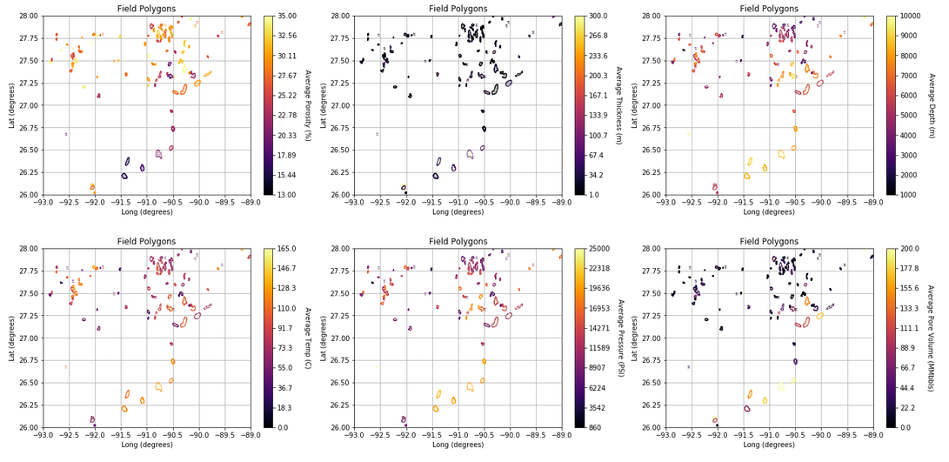
The Data and Data Loading
Loaded reservoir polygons in original coordinates, latitude and longitude (degrees)
Reservoir averag

Slide 7
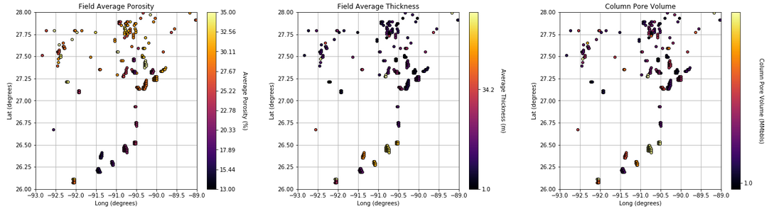
The Data and Data Loading
Loaded reservoir polygons in original coordinates, rasterized to the assumed 2D regular grid for mapping

Slide 8
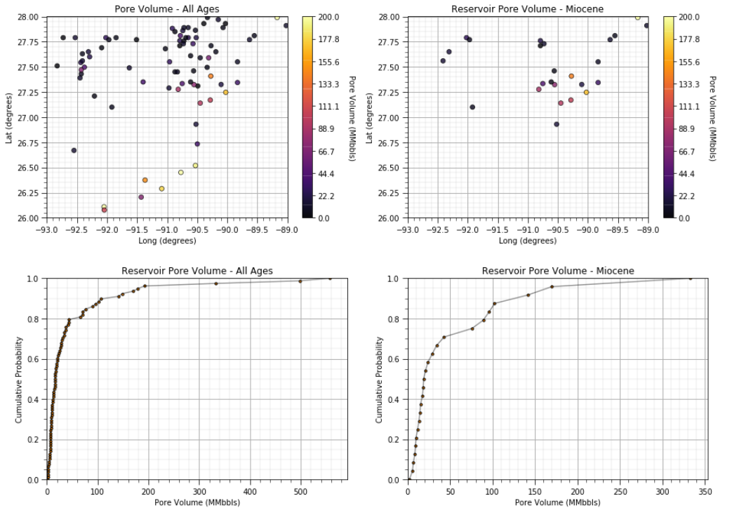
The Data and Data Loading
Reservoir Centroids-based DataFrame calculated:
Centroids calculated over the rasterized reservoirs
Matched with all reservoir averaged features
Areas calculated and added

Slide 9
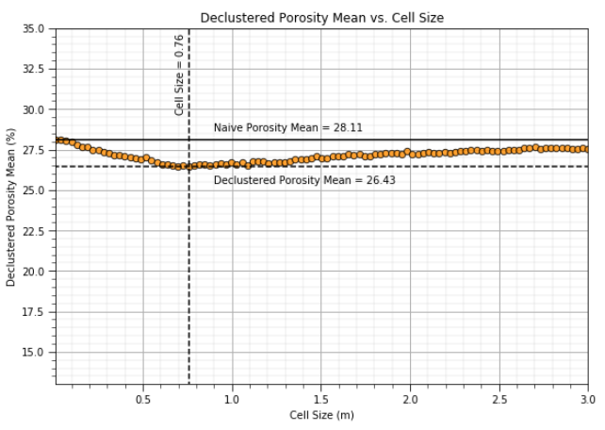
Debiasing Spatial Data
Spatial data debiasing with cell-based declustering:
Calculation of declustering weights
Development of flexible, diagnostic plotting functions
Inclusion of statistical weighting to means, variances and distributions

Slide 10
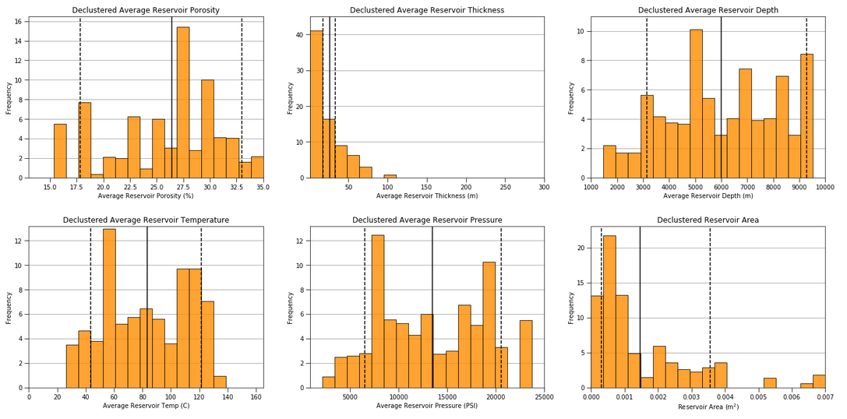
Debiasing Spatial Data
Spatial data debiased reservoir scale feature distributions

Slide 11
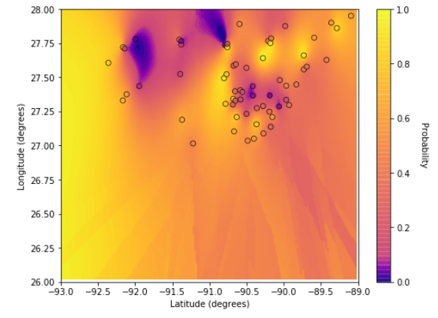
Spatial Data Anomaly Detection
For data cleaning, segmentation of populations for improved analysis and model accuracy:
Spatial continuity-based anomaly detection (Liu and Pyrcz, 2021).
Indicating reservoirs that are significantly different than neighboring reservoirs.
Shown with Miocene reservoirs only.

Slide 12
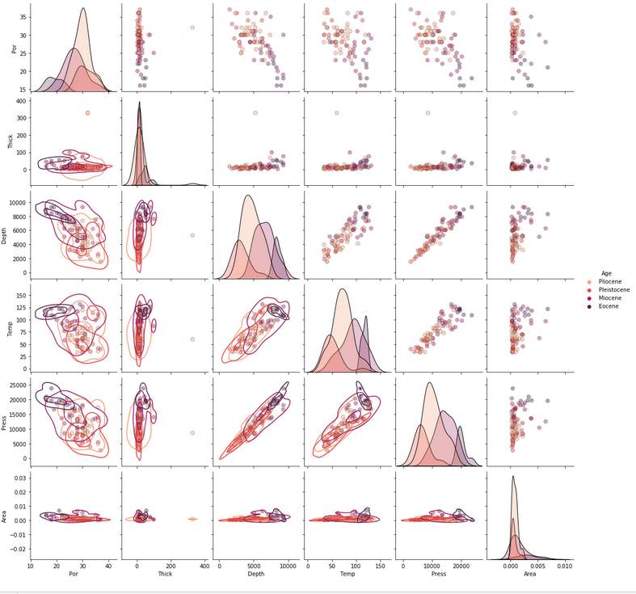
Multivariate Analysis
Matrix scatter plots:
For pairwise feature evaluation to identify potential issues for feature selection, feature projection and correlation analysis.
With by-group joint distribution fits by kernel density estimation
Identification of bivariate outliers, linearity and homoscedasticity

Slide 13
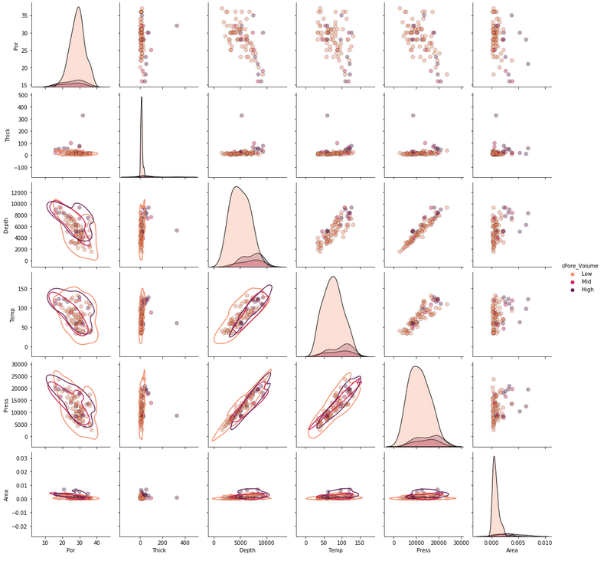
Multivariate Analysis
Matrix scatter plots
For pairwise feature evaluation to identify potential issues for feature selection, feature projection and correlation analysis.
With by-group joint distribution fits by kernel density estimation
Identification of bivariate outliers, linearity and homoscedasticity

Slide 14
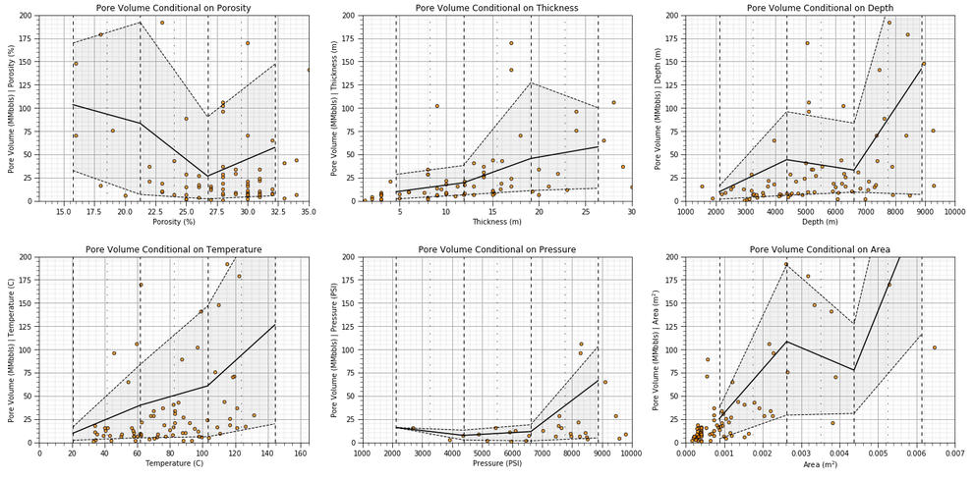
Multivariate Analysis
Conditional distributions to evaluate nonlinear, heteroscedastic relationships

Slide 15
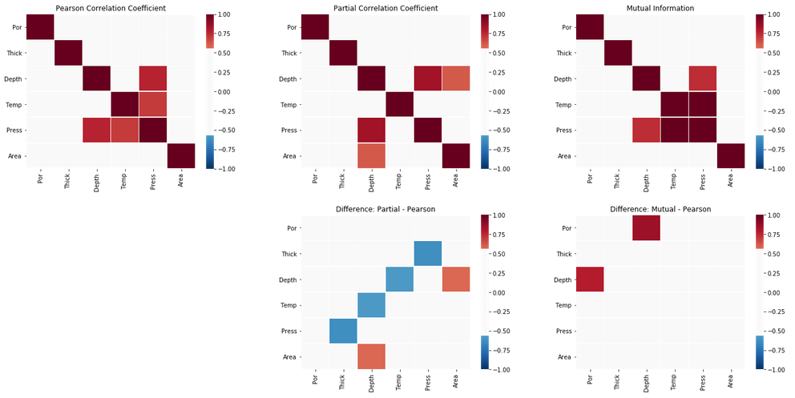
Feature Selection
Enhanced pairwise feature correlation analysis with partial correlation and mutual information:
Difference between partial and Pearson indicate influence of other features.
Difference between mutual and Pearson indicate influence of nonlinearity and heteroscedasticity

Slide 16
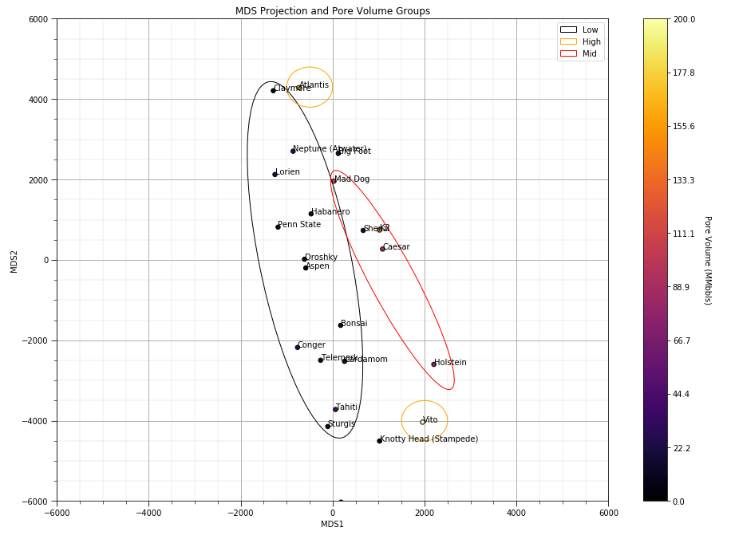
CO2 Storage Groups
Multidimensional scaling (MDS) to project reservoirs to a lower dimensionality space:
Preserving reservoir pairwise dissimilarity while projecting from m dimensional (all predictor features) to 2D
Posting response feature, static pore volume (MMbbls) groups, low, mid and high
Natural groups in MDS space

Slide 17
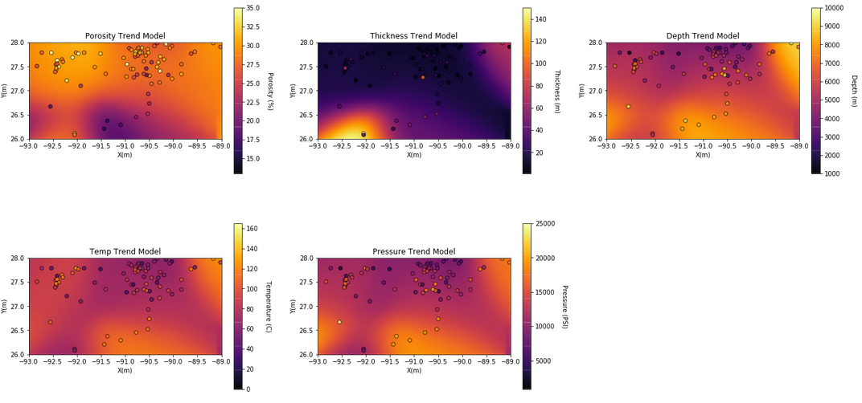
Spatial Feature Trend Models
Computational efficient trend modeling with sparse data convolution

Slide 18
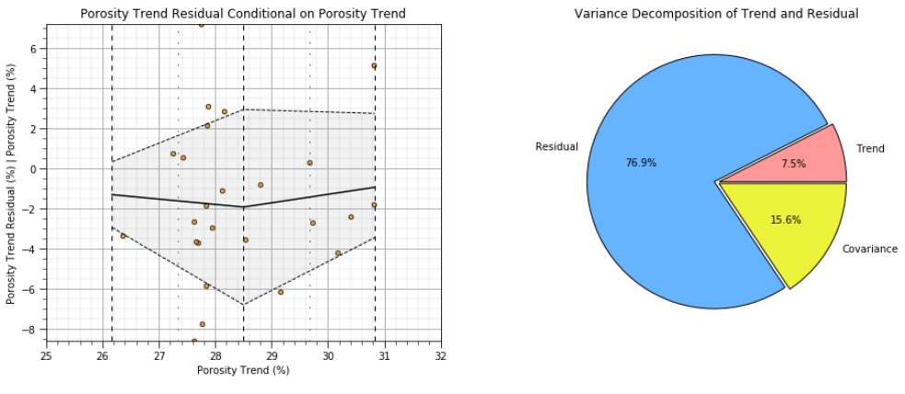
Spatial Feature Trend Models
Trend diagnostic plots to evaluate trend quality:
check for residual and trend relationships and decomposition of variance between trend and residual

Slide 19
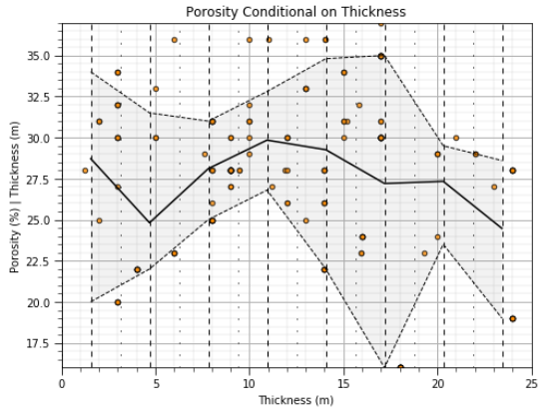
Static Pore Volume Modeling
Use of rasterized predictor features to calculate static pore volume maps with uncertainty:
Accounting for reservoir extent in the models
Check for relationship between reservoir average porosity and average thickness
Currently supports assumption of independence for uncertainty analysis

Slide 20
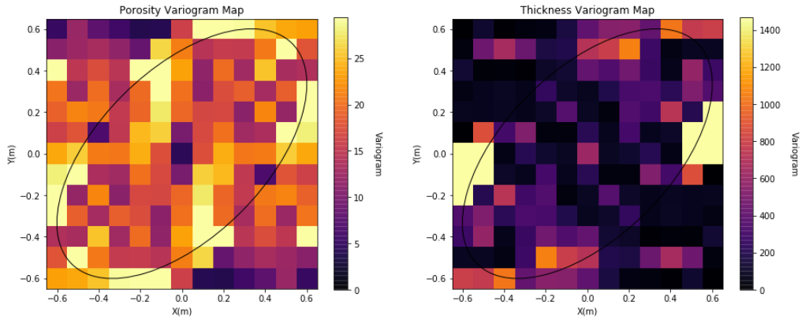
Static Pore Volume Modeling
Calculation of 2D predictor feature spatial continuity models:
Use of variogram maps for improved visualization and diagnostics

Slide 21
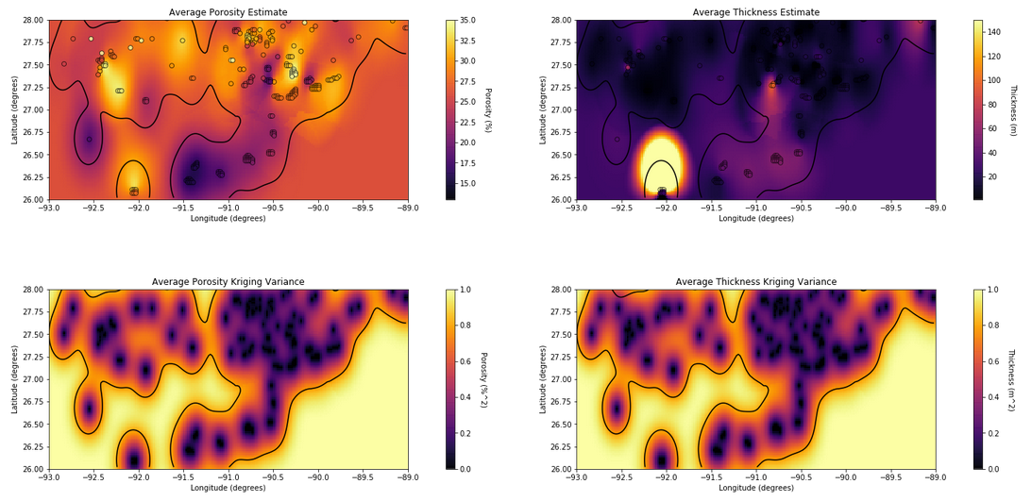
Static Pore Volume Modeling
Calculation of 2D predictor feature spatial estimates:
Includes local error variance minimized estimates and estimation variance (uncertainty)

Slide 22
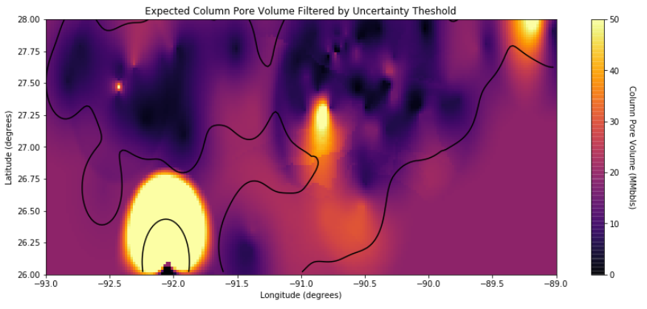
Static Pore Volume Modeling
Calculation of 2D map of static pore volume:
Local most likely estimate for by-grid column reservoir pore volume.
Extrapolation away from known reservoirs included with contour.

Slide 23
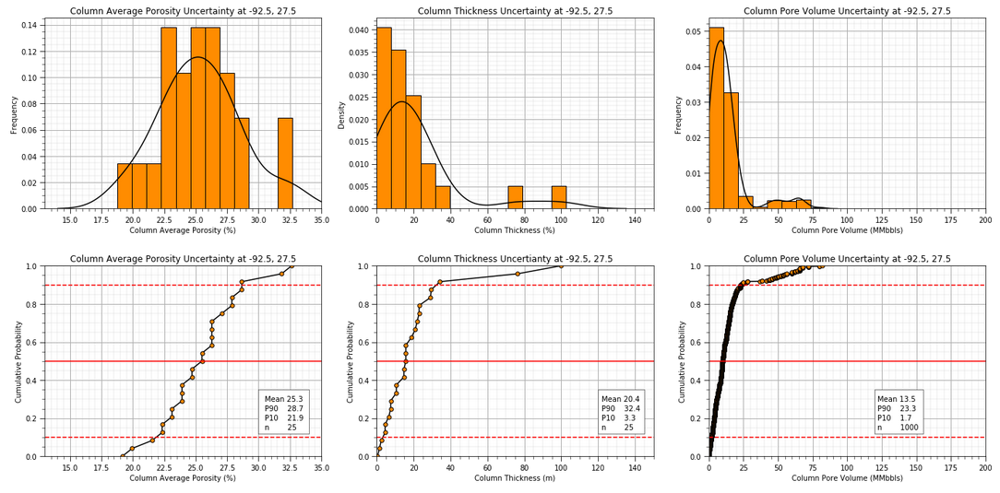
CO2 Storage Uncertainty Maps
Local feature and static pore volume uncertainty models for any location:
No accounting for reservoir boundaries

Slide 24
Transfer Function
Use of rasterized predictor features to calculate static pore volume maps with uncertainty:
Check for relationship between reservoir average porosity and average thickness
Currently supports assumption of independence for uncertainty analysis

Slide 25
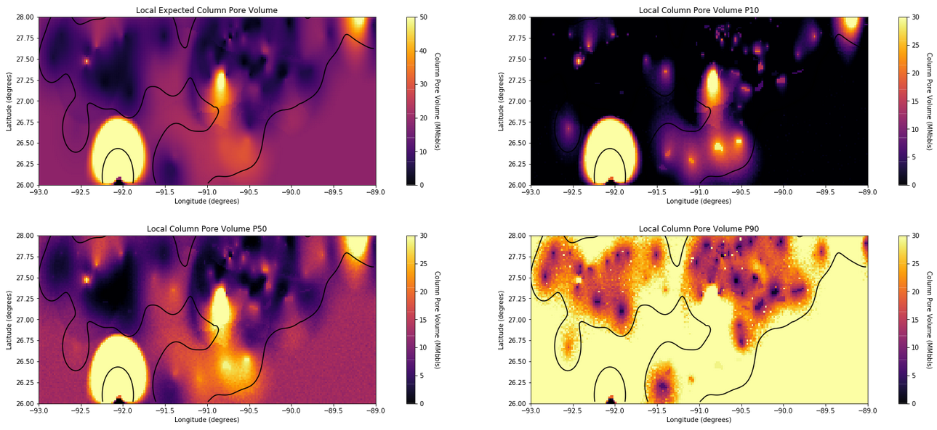
Static Pore Volume Modeling
Calculation of 2D uncertainty models:
Local P10, P50 and P90 static pore volume predictions for all columns

Slide 26
Next Steps based On IHSMarkit Feedback
Coordinate transformations given the preferred projection
Integrate improved transfer function to go beyond static pore volume for oil and gas reservoirs
Addition of risk maps.
Additional feedback?
local risk maps, filters by threshold and probability of success, distance to emitter
add naïve histograms to declustered
saline aquifer data

Slide 27
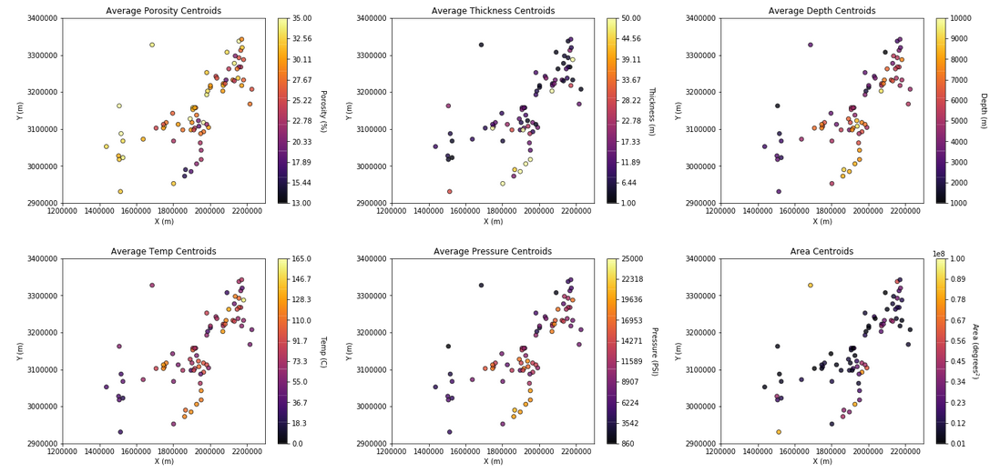
Updates – Coordinate Projection
Assumed WGS84, updated areas and volumetric calculations.

Slide 28
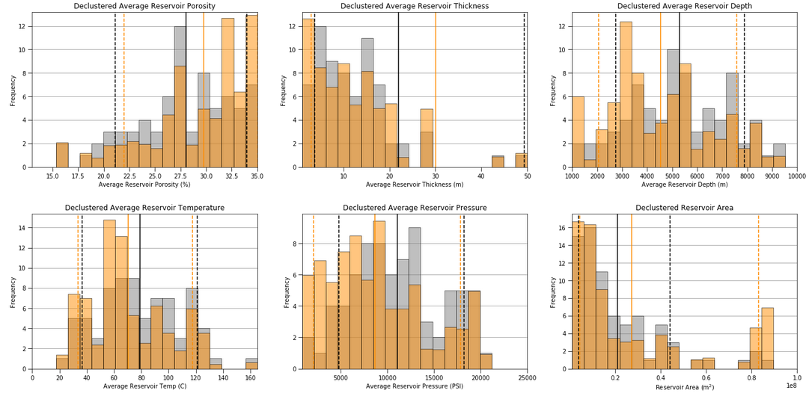
Updates – Declustered Distributions

Slide 29
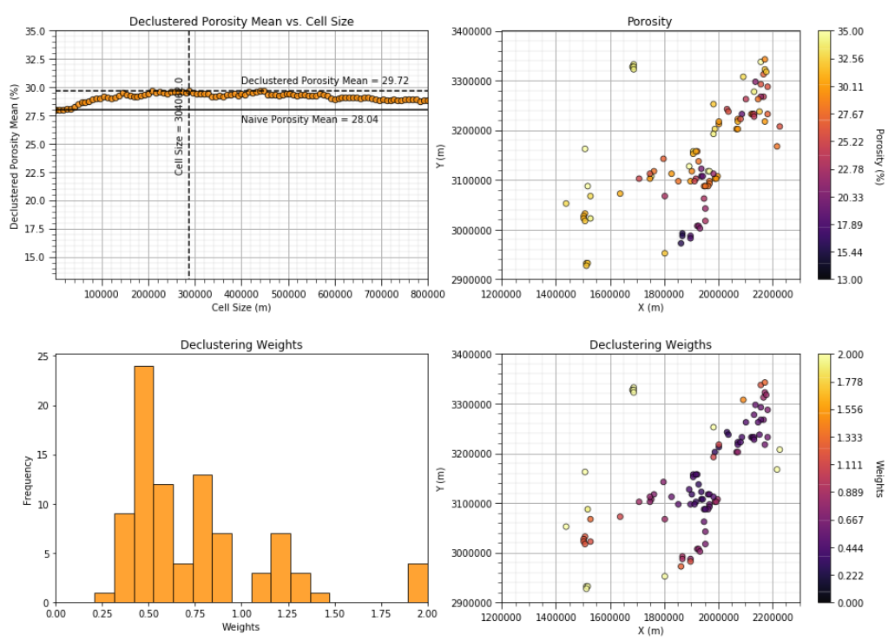
Updates – Declustered Distributions

Slide 30
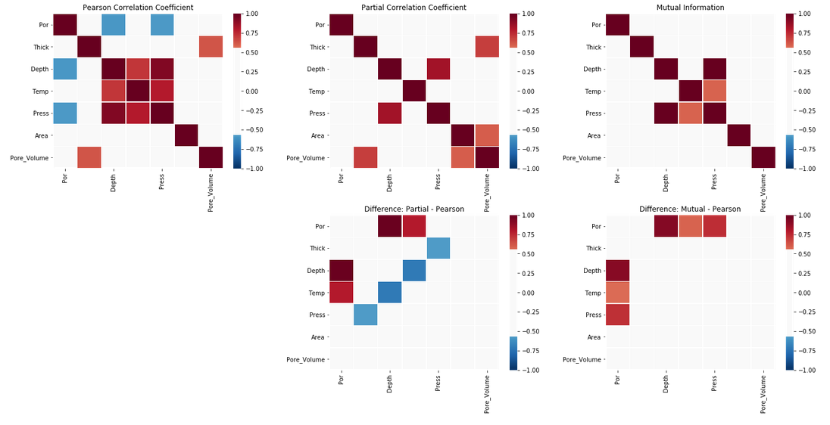
Updates – Add Response Feature to Correlation Analysis

Slide 31
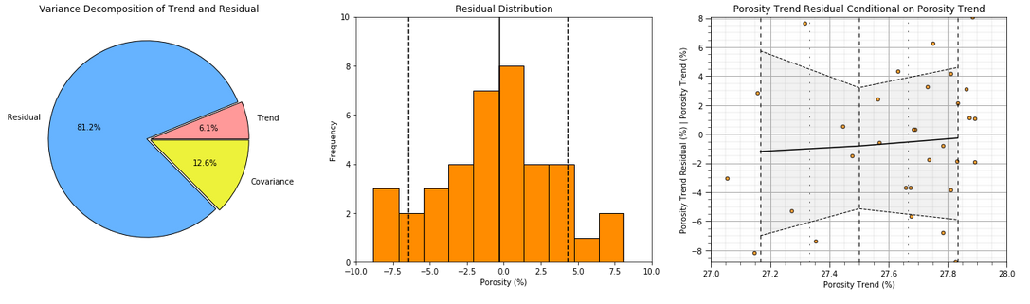
Updates – Trend Diagnostics

Slide 32
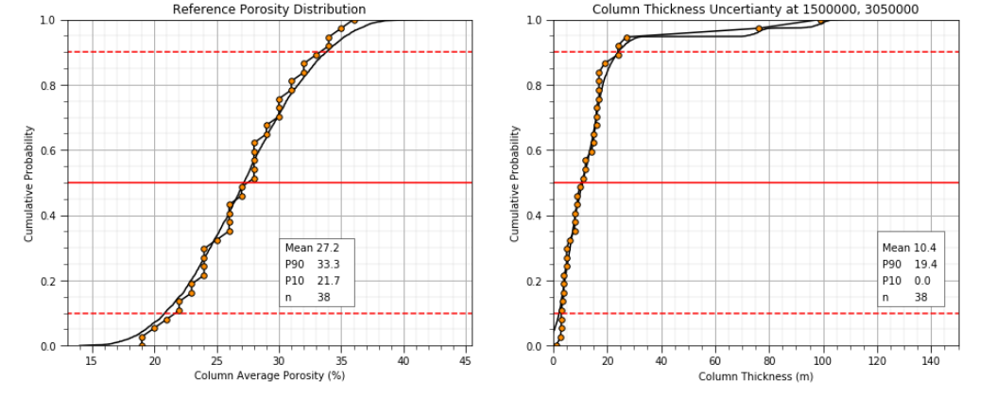
Updates – Local Uncertainty with Reference Distributions

Slide 33
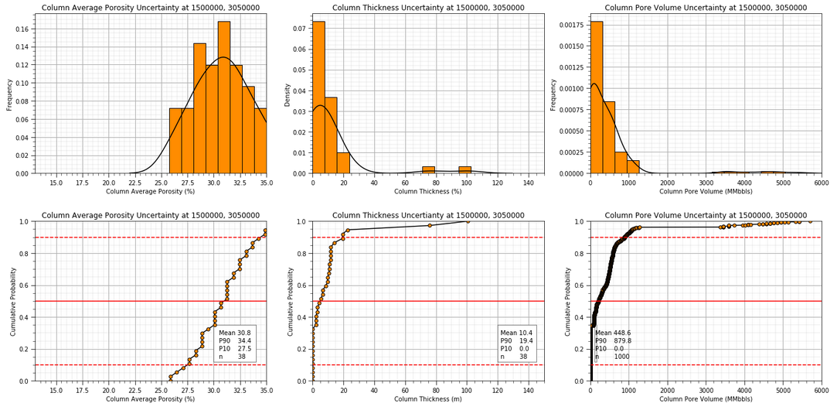
Updates – Local Uncertainty with Reference Distributions

Slide 34
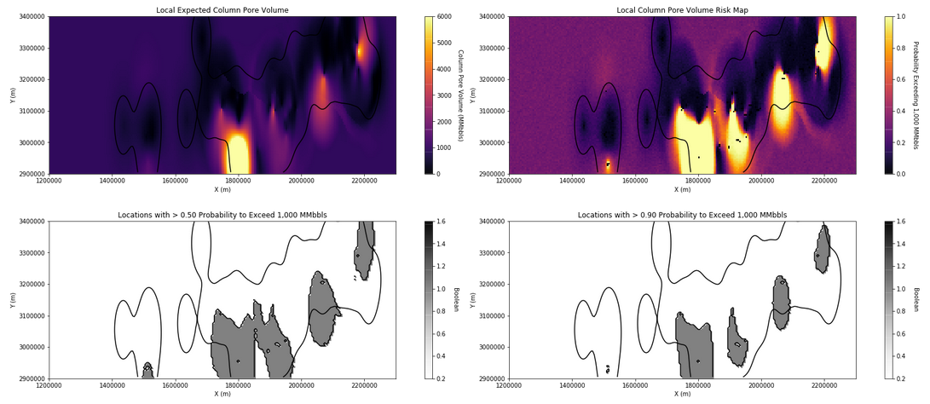
Updates – Risk Maps

Slide 35
Updates – Risk Maps

Slide 36
Updates – Risk Maps

Slide 37
Saline Aquifers
Fast sprint to demonstrate workflow building blocks.
Trend based Imputation and Prediction with:
robust use of statistics
uncertainty models
rapid calculations for real-time feedback
2D + 1D approach
New Steps:
dask Python package for loading and managing large datasets
1D trend displays
2D + 1D trend based imputation and pre-drill prediction

Slide 38
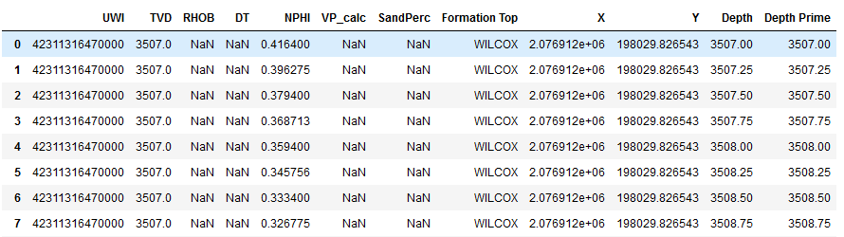
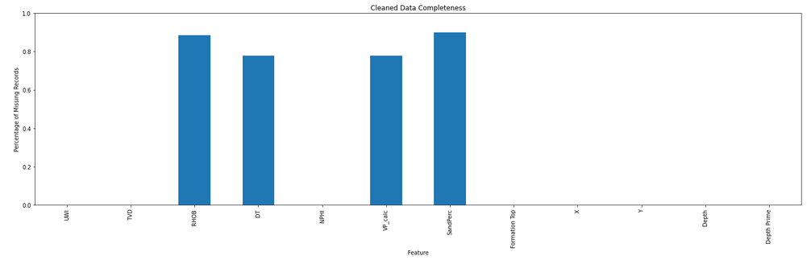
Working with Big Data
dask Python package provides functionality for efficiently working with big data
10 seconds to create dask DataFrame with 235 M rows
type casted Formation Top as object
10 seconds to filtere to WILCOX Formation Tops only for 2.5 M rows
then converted to Pandas DataFrame
removed records missing NPHI for 562 k rows, 22 k without missing values, 54 unique wells
converted any records with NPHI in percent to fraction
Depth Prime is TVD with missing values set as Depth
Cleaned DataFrame preview.
Proportion of missing values in cleaned data.

Slide 39
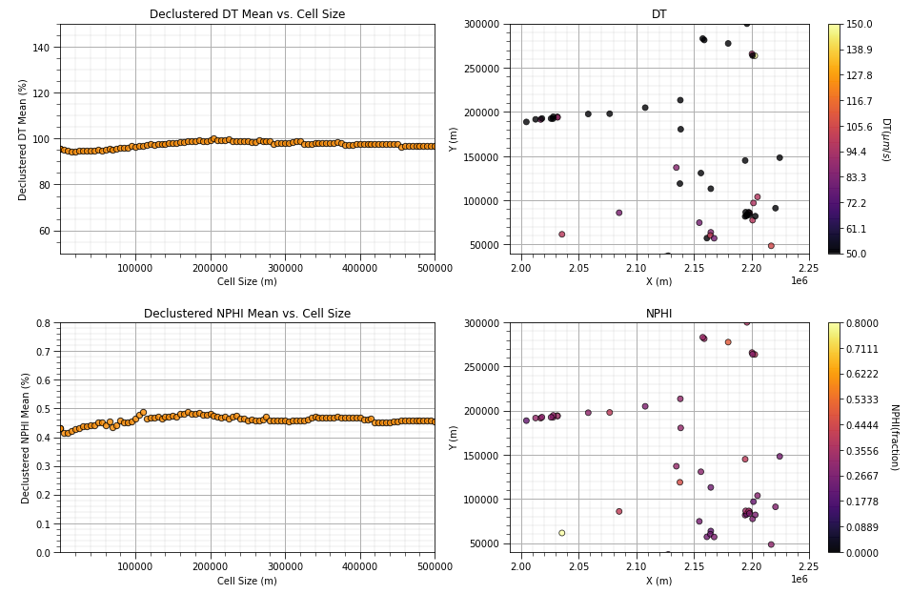
Debiasing Spatial Data
Spatial data debiasing with cell-based declustering:
Calculation of declustering weights
Development of flexible, diagnostic plotting functions
Inclusion of statistical weighting to means, variances and distributions
Declustering by-feature
Examples of by-feature debiasing, up to 5% correction in mean.

Slide 40
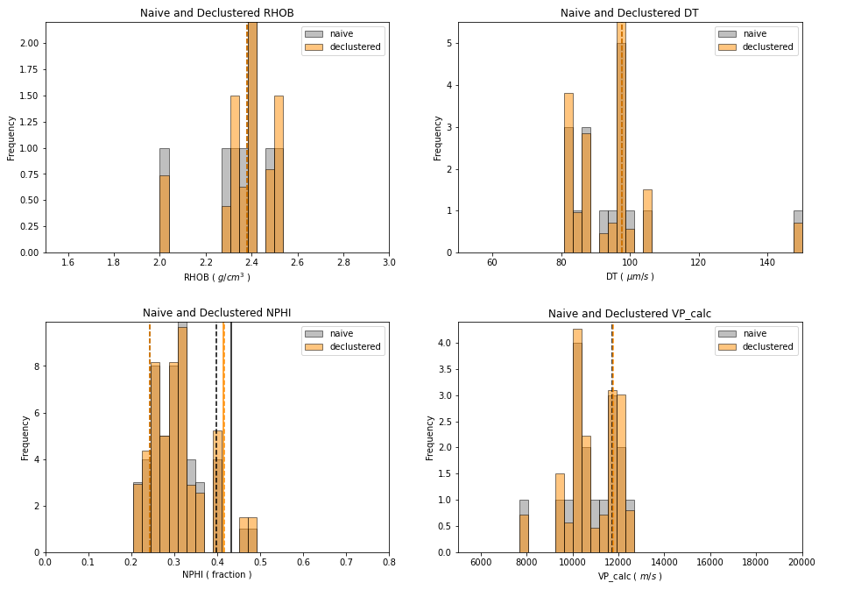
Debiasing Spatial Data
Spatial data debiased reservoir scale feature distributions
naïve and debiased feature distributions.

Slide 41
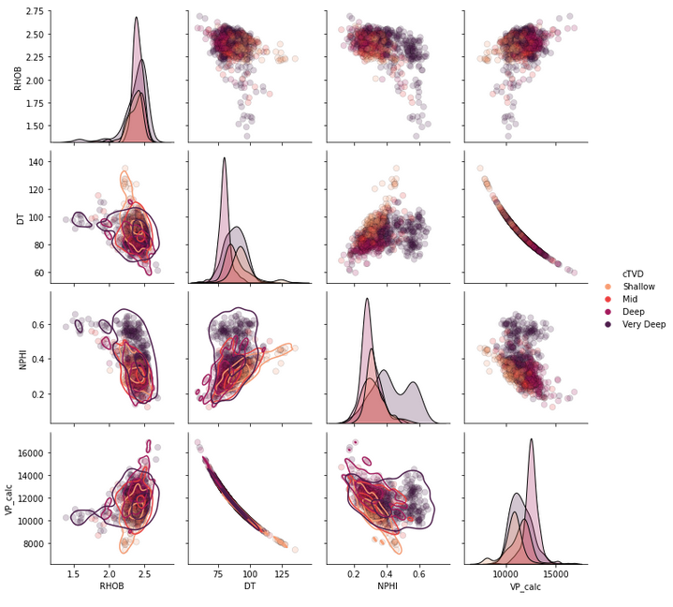
Multivariate Analysis
Matrix scatter plots:
For pairwise feature evaluation to identify potential issues for feature selection, feature projection and correlation analysis.
With by-group joint distribution fits by kernel density estimation
Identification of bivariate outliers, linearity and homoscedasticity

Slide 42
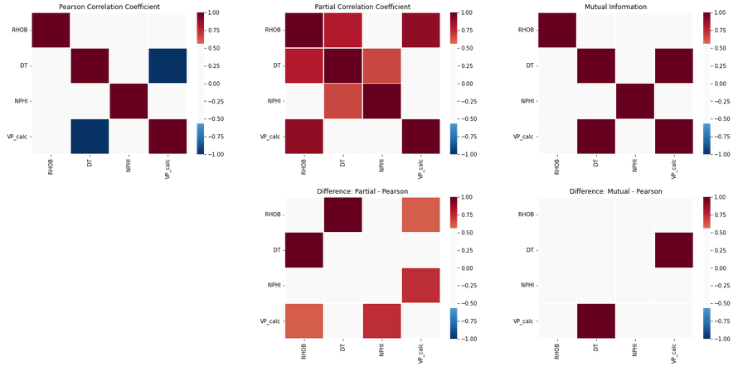
Feature Selection
Enhanced pairwise feature correlation analysis with partial correlation and mutual information:
Difference between partial and Pearson indicate influence of other features.
Difference between mutual and Pearson indicate influence of nonlinearity and heteroscedasticity
Outliers are Reducing Correlation
Nonlinear Structures are Reducing Correlation

Slide 43
CO2 Storage Groups
To be completed. Need to apply imputation workflows first.
Multidimensional scaling (MDS) to project reservoirs to a lower dimensionality space:
Preserving reservoir pairwise dissimilarity while projecting from m dimensional (all predictor features) to 2D
Posting response feature, static pore volume (MMbbls) groups, low, mid and high
Natural groups in MDS space

Slide 44
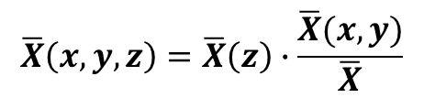
2D + 1D Modeling Workflow
Calculate 2D Area and 1D Vertical trends:
Combine 1D and 2D 3D.
2D Areal Trend From Well Averages
Average
over Wells
Model and Well Data
2D Trend Model
1D Vertical Trend Layer Averages
$$\overline{X}\left(x,y,z\right)=\overline{X}\left(z\right)∙\frac{\overline{X}(x,y)}{\overline{X}}$$
Average
over Layers
1D Trend Model
3D Trend Model

Slide 45
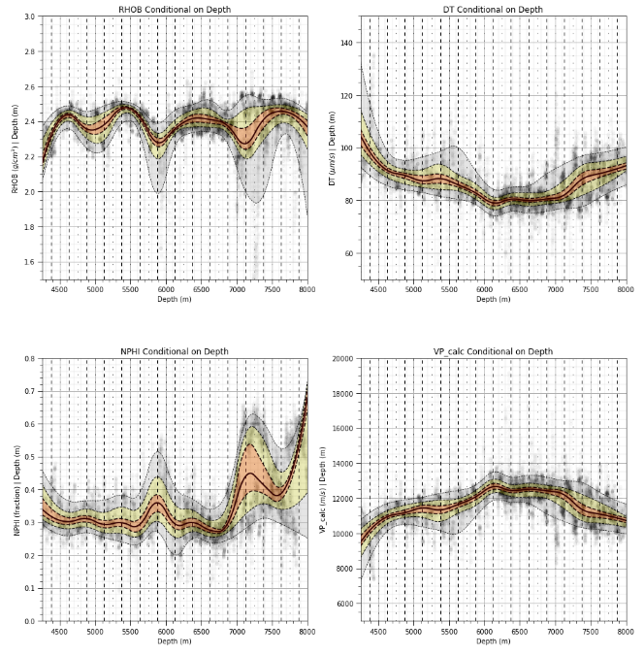
Spatial Feature Trend Models
Computational efficient trend modeling with moving window conditional distributions.
1D vertical trends with uncertainty intervals
sampled conditional distributions with specified binning rate to reduce noise
applied spline curve of low order to further reduce noise and improve interpolation and extrapolation
Vertical trends by 1D moving window in depth, P40-P60 orange, P25-P75 yellow, P10-P90 grey.

Slide 46
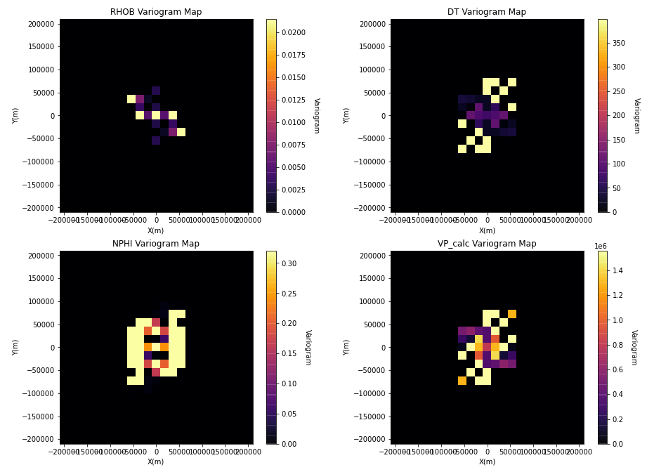
Spatial Feature Trend Models
To be completed.
Spatial Continuity Analysis
Trend and directionality detection
Variogram maps to detect spatial trends and continuity major and minor directions.

Slide 47
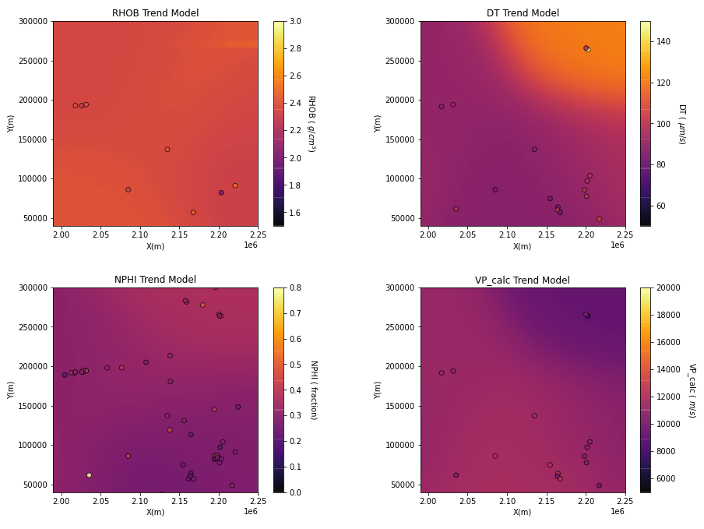
Spatial Feature Trend Models
Computational efficient trend modeling with sparse data convolution
by-well averages
sparse data convolution for fast calculation

Slide 48
Spatial Feature Trend Models
Trend diagnostic plots to evaluate trend quality:
check for residual and trend relationships and decomposition of variance between trend and residual

Slide 49
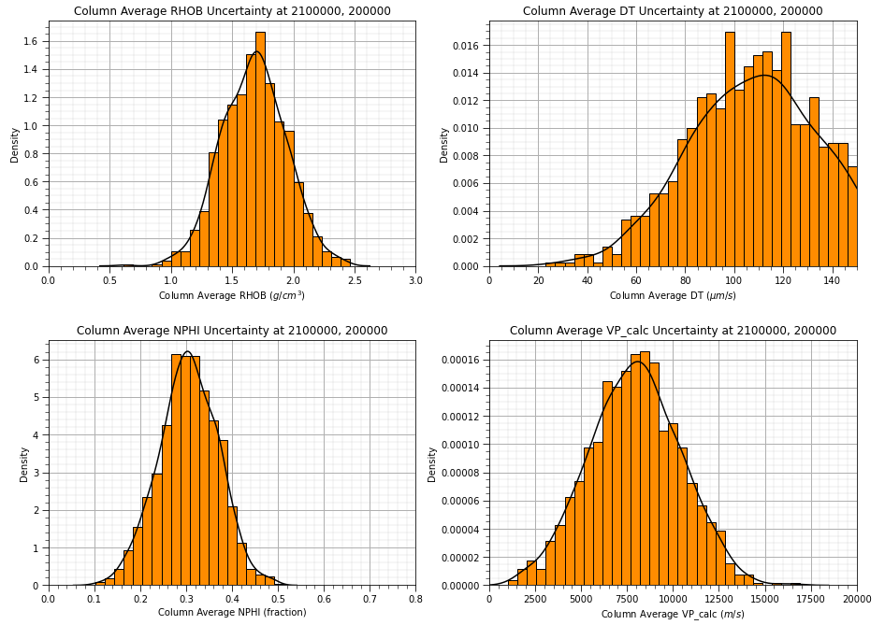
Local Feature Uncertainty Models
Local feature and static pore volume uncertainty models for any location:

Slide 50
Future Work
Impliment feature imputation and check to densify multivariate dataset to support
MDS
Predictor Feature Importance and Sensitivity
Pore Volume Calculation with Uncertainty Models

